Slide 1
CODE ALPHA INTERNSHIP
NAME: Theophilus Eshun
DOMAIN: Cyber security
Intern id: CA/MY3/5360
TASK: PHISHING AWARENESS TRAINING

Slide 2
Cyber Security — Internship Overview
This internship program offers hands-on experience in cybersecurity principles and practices. CodeAlpha is a leading software development company dedicated to building secure and resilient systems. The internship equips students with skills to identify vulnerabilities, implement security measures, and conduct risk assessments. Interns will learn about network security, ethical hacking, encryption, and threat detection, gaining practical exposure through real-world projects. Expert mentorship and a collaborative environment will prepare interns to contribute effectively to organizational security.

Slide 3

Phishing Awareness Training
Create a presentation or online module focused on phishing attacks.
● Explain how to recognize phishing emails and fake websites.
● Educate about social engineering tactics used by attackers.
● Provide best practices and tips to avoid falling victim.
● Include real-world examples and interactive quizzes for better engagement.

Slide 4
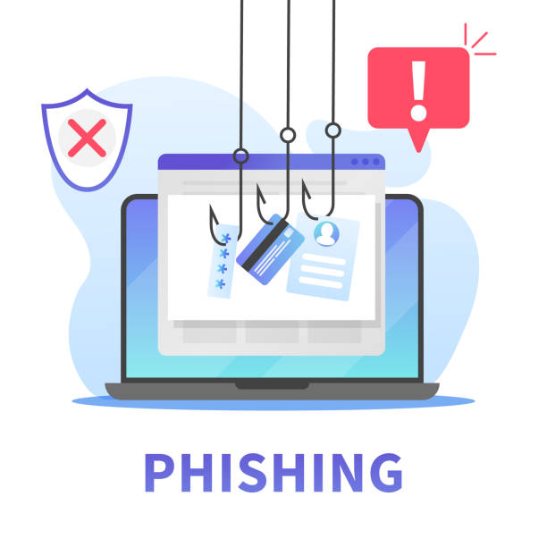
WHAT IS PHISHING?
Phishing is a type of social engineering where attackers try to trick people into revealing sensitive information like passwords, credits card details, or personal data. They often use fake emails, messages, or websites that appear legitimate.

Slide 5
HOW TO RECOGNISE PHISHING ATTACKS

Slide 6
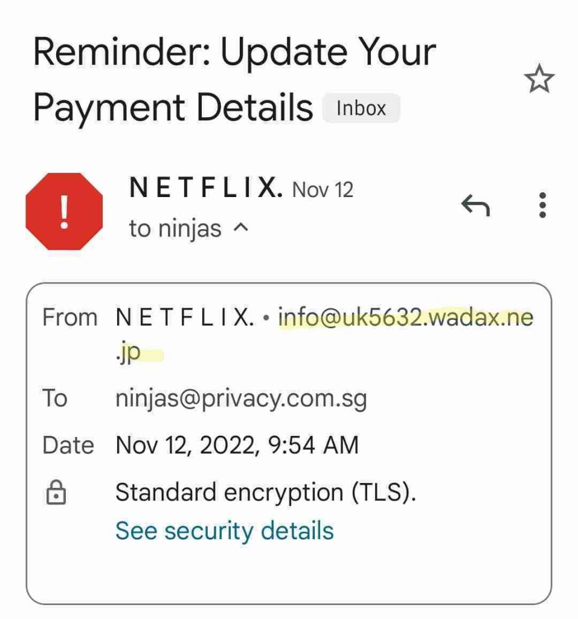
HOW TO RECOGNISE PHISHING ATTACKS
Suspicious Sender: Check the sender's email address closely. Scammers often use addresses that look similar to legitimate ones but have slight variations.

Slide 7
HOW TO RECOGNISE PHISHING ATTACKS
Urgency & Fear Tactics: Phishing emails often create a sense of urgency, claiming your account is compromised or requiring immediate action. Check the image in the next slide;

Slide 8
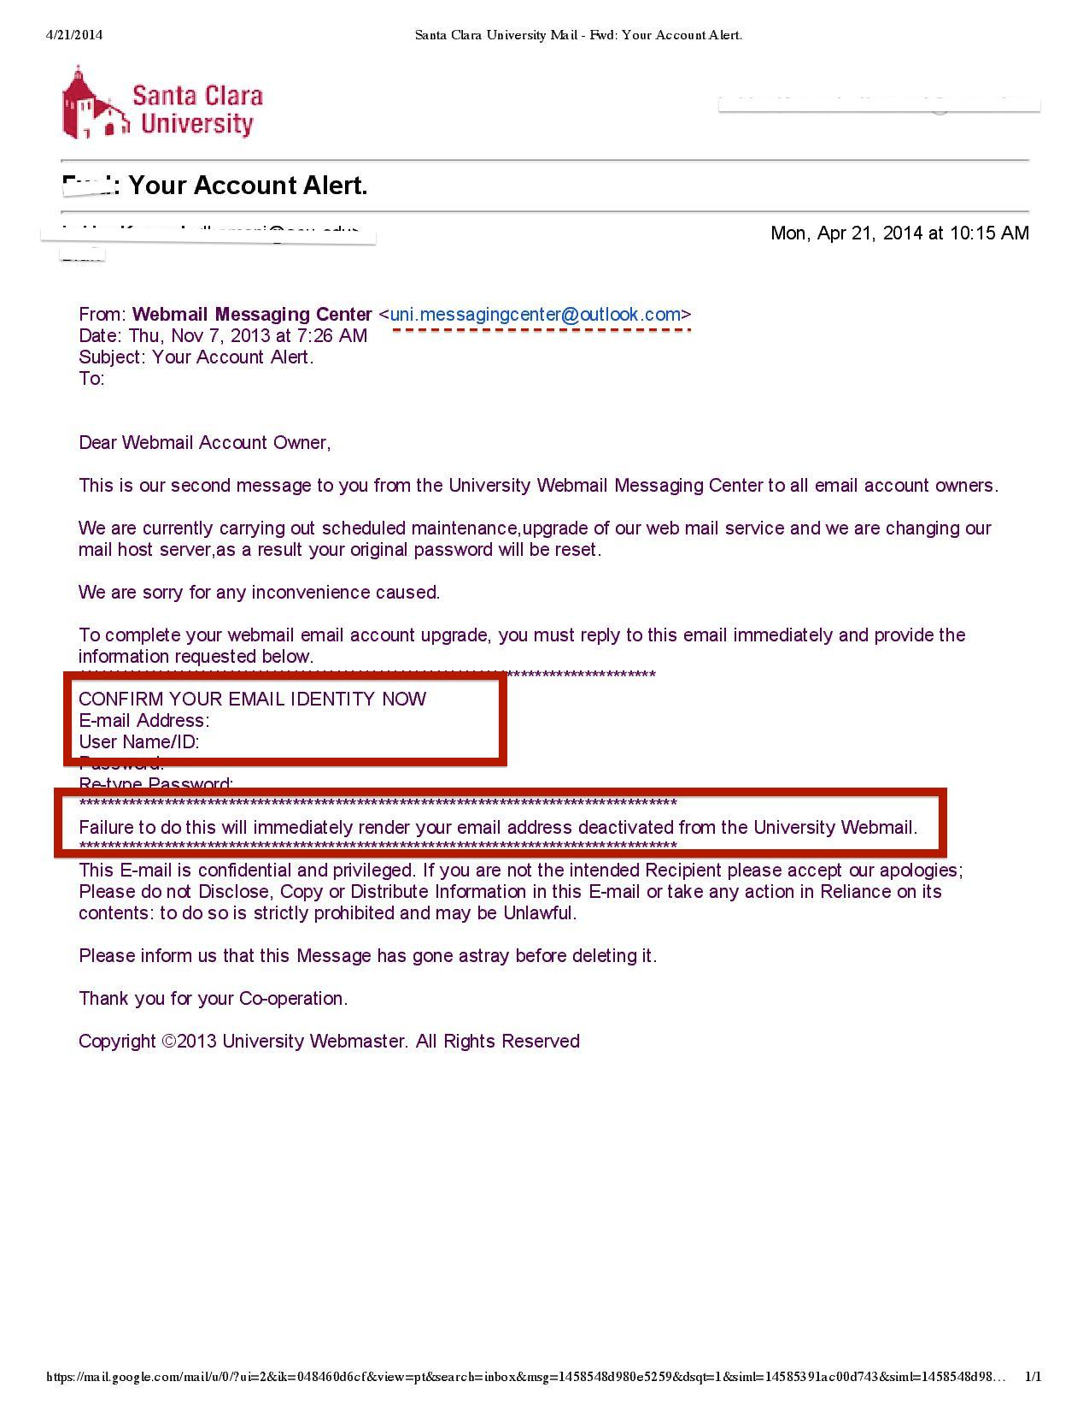

Slide 9
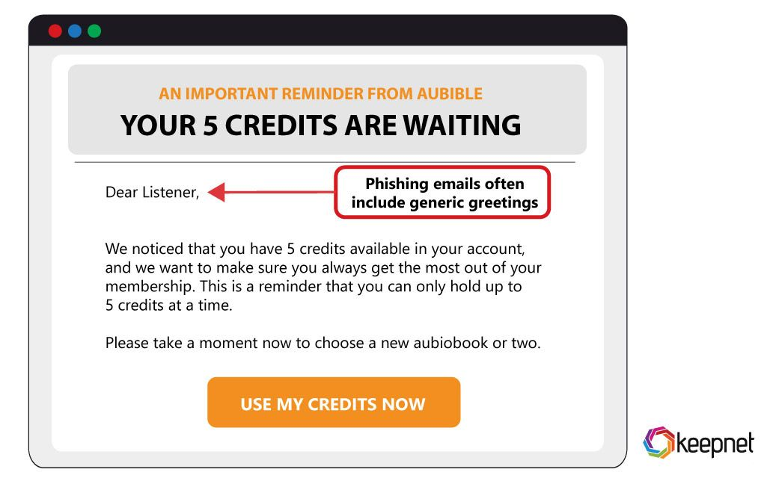
HOW TO RECOGNISE PHISHING ATTACKS
Generic Greetings: If an email starts with "Dear Customer" instead of using your name, it may be suspicious.

Slide 10
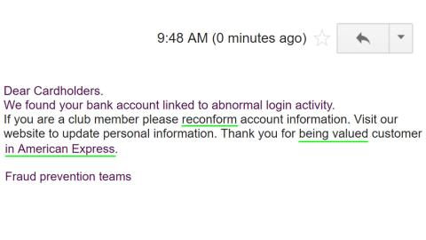
HOW TO RECOGNISE PHISHING ATTACKS
Poor Grammar & Spelling: Legitimate organisations proofread their communications. Errors can be a sign of a scam.

Slide 11
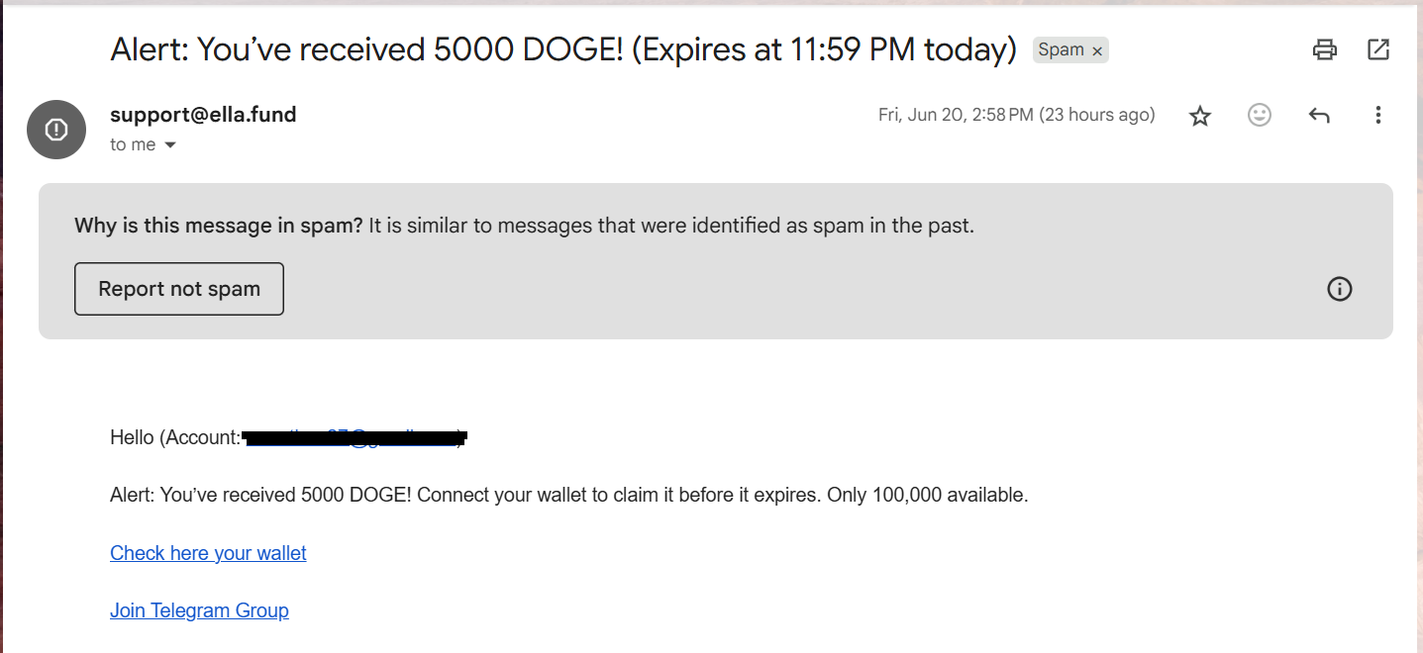
HOW TO RECOGNISE PHISHING ATTACKS
Unexpected Links or Attachments: Don't click links or download attachments from unknown sources—they might contain malware.

Slide 12
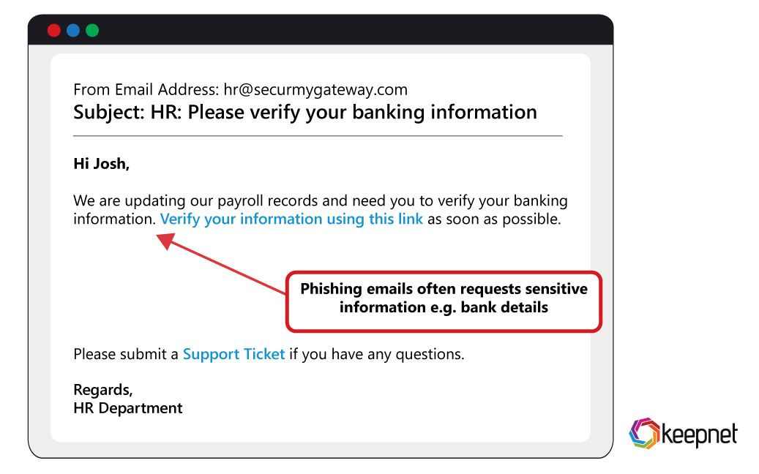
HOW TO RECOGNISE PHISHING ATTACKS
Requests for Sensitive Information: No reputable company will ask for your password, payment details, or personal information via email.

Slide 13
HOW TO RECOGNISE FAKE EMAILS

Slide 14
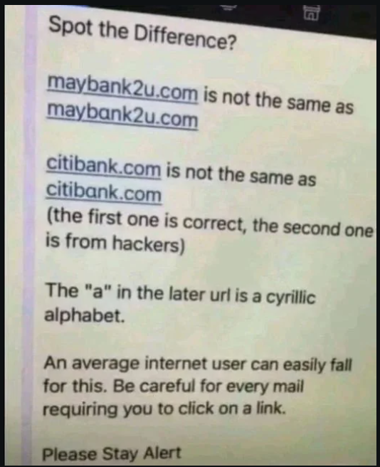
HOW TO RECOGNISE FAKE EMAILS
Look at the URL: Fake websites often use slightly altered domain names (e.g., "microsotf.com" instead of "microsoft.com").

Slide 15

HOW TO RECOGNISE FAKE EMAILS
Check for HTTPS: Secure sites have "https://" in the address bar. If a website lacks this or has a strange certificate warning, avoid it.

Slide 16
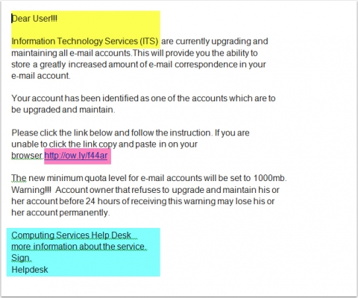
HOW TO RECOGNISE FAKE EMAILS
Poor Design & Low-Quality Content: Many fake sites have low-resolution images, bad formatting, or broken links.

Slide 17
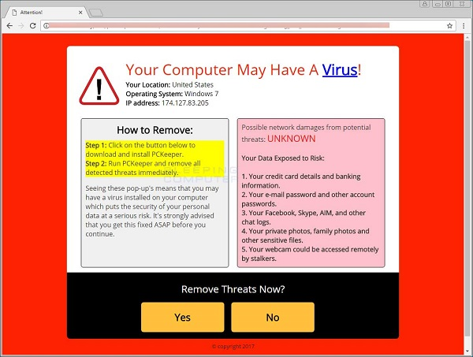
HOW TO RECOGNISE FAKE EMAILS
Unexpected Pop-ups & Ads: Fake websites often display intrusive pop-ups that request personal information or prompt downloads.

Slide 18
HOW TO RECOGNISE FAKE EMAILS
No Contact Information: Legitimate businesses provide contact details like phone numbers and physical addresses.

Slide 19


Slide 20
WHAT IS SOCIAL ENGINEERING?
Social engineering is a deceptive strategy that attackers use to manipulate individuals into revealing sensitive information or performing actions that compromise security. Instead of hacking systems directly, they exploit human psychology.

Slide 21
SOCIAL ENGINEERING TACTICS USED BY ATTACKERS
Phishing
Attackers send fraudulent emails or messages pretending to be trustworthy sources (banks, tech support, colleagues).
They trick victims into clicking malicious links, downloading malware, or providing personal details.

Slide 22
SOCIAL ENGINEERING TACTICS cont...
Pretexting
This involves creating a fabricated scenario to gain trust.
Attackers impersonate authority figures (police, IT staff, or executives) to extract confidential data.

Slide 23
SOCIAL ENGINEERING TACTICS cont...
Baiting
Offers something enticing, like free downloads or giveaways, to lure victims into compromising their security.
Malicious files disguised as software updates or tempting rewards often contain malware.

Slide 24
SOCIAL ENGINEERING TACTICS cont...
Tailgating (Piggybacking)
Attackers gain physical access to restricted areas by closely following authorised personnel.
They may pretend to have forgotten their access card or engage in friendly conversation to slip in unnoticed.

Slide 25
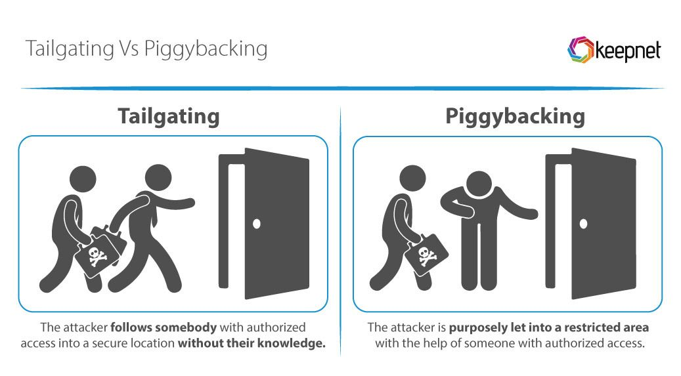

Slide 26
SOCIAL ENGINEERING TACTICS cont...
Quid Pro Quo
Scammers offer fake services or help (e.g., IT support) in exchange for access to systems or information.
Victims unknowingly hand over credentials or sensitive data.

Slide 27
SOCIAL ENGINEERING TACTICS cont...
Impersonation & Vishing (Voice Phishing)
Attackers call individuals pretending to be a trusted contact, like a bank representative or tech support.
They manipulate victims into disclosing passwords or financial details over the phone.

Slide 28
BEST PRACTICES AND TIPS TO AVOID FALLING VICTIM.
Staying safe from phishing attacks and social engineering requires vigilance and smart security habits. Next are some best practices to help you avoid falling victim:

Slide 29


Slide 30
BEST PRACTICES AND TIPS CONT...
Strengthen Your Cyber Hygiene
Use Strong, Unique Passwords: Avoid common phrases. Mix uppercase, lowercase, numbers, and symbols. [e.g. (0bib@)2deW$r1d]
Enable Multi-Factor Authentication (MFA): Adds an extra layer of security, making it harder for attackers to gain access.[e.g Fingerprint, facial ID or SMS token]
Keep Software & Systems Updated: Security patches protect against vulnerabilities exploited by hackers.
Install & Maintain Antivirus Software: Reliable security tools detect and prevent threats.

Slide 31
BEST PRACTICES AND TIPS CONT...
2. Stay Alert & Think Before Acting
Verify Requests for Sensitive Information: Don’t share personal details unless you're 100% sure of the source.
Avoid Clicking Suspicious Links or Attachments: Always hover over links to check the real destination.
Double-Check Email Senders: Attackers often use slight variations of legitimate addresses.

Slide 32
BEST PRACTICES AND TIPS CONT...
3. Secure Your Online Presence
Limit What You Share Publicly: Avoid revealing personal details on social media that could be used against you.
Be Cautious with Free Offers: Baiting tactics often disguise malware as freebies or enticing downloads.
Use Encrypted Communication: Prefer secure messaging platforms for sensitive discussions.

Slide 33
BEST PRACTICES AND TIPS CONT...
4. Train Yourself & Others
Educate Family & Friends: Cybersecurity awareness helps prevent scams from succeeding.
Practice recognising scams: Test yourself by reviewing common phishing attempts or fake websites.
Report Suspicious Activities: If you encounter potential threats, notify the IT security teams or authorities.

Slide 34
BEST PRACTICES AND TIPS CONT...
5. Verify Everything!
When in doubt, contact organisations directly instead of clicking links in unexpected emails.
Don’t trust urgent threats demanding quick action-real companies will give you time to verify issues.
Be sceptical of random requests for login credentials, money, or confidential information. Cybercriminals exploit human emotions like fear, trust, and urgency. Stay calm, think critically, and always verify before acting.

Slide 35
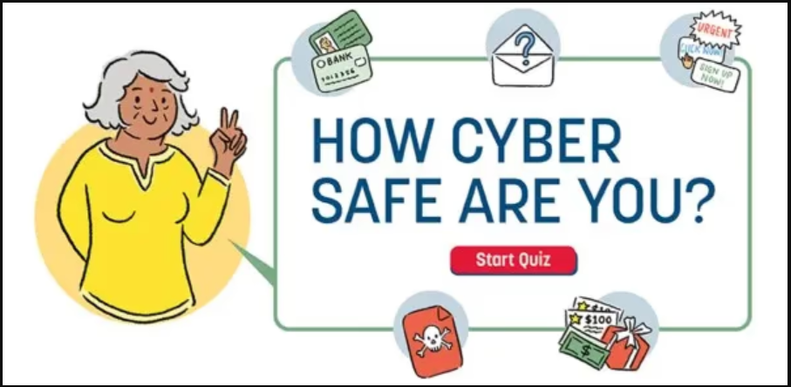

Slide 36
Cybersecurity Quiz: Spot the Scam!
You received an email from your bank saying your account is compromised. It asks you to verify your identity by clicking a link. What do you do?
Click the link and enter your details to secure your account.
Call your bank directly to verify the email
Ignore the email—banks never send security alerts

Slide 37
Cybersecurity Quiz: cont...
A stranger messages you online, offering a free software download that will "speed up your PC." How do you respond?
Accept the offer—it sounds useful.
Google the software to see if it's legitimate.
Ignore the message—it’s likely a scam

Slide 38
Cybersecurity Quiz: cont...
You get a phone call from someone claiming to be your company’s IT department, asking for your login details to fix a system issue. How do you respond?
Provide the details—they need them to fix the issue
Verify the caller by contacting your company’s IT team directly.
End the call—it’s a scam

Slide 39
Cybersecurity Quiz: cont...
While browsing online, a pop-up appears saying you've won a free smartphone and need to enter your details to claim it. How should you respond?
Fill out the form quickly—free gifts are exciting!
Close the pop-up immediately—it’s likely a scam.
Call the company to verify the offer.

Slide 40
Cybersecurity Quiz: cont...
A friend sends you a link to download a "new exclusive movie" before its official release. What should you do?
Click the link-your friend wouldn’t send anything harmful.
Check the sender and verify the source before clicking.
Avoid downloading-unverified links may contain malware

Slide 41
Cybersecurity Quiz: cont...
You receive a text message from an unknown number claiming to be your bank, asking you to confirm a recent transaction. What do you do?
Reply to the text and provide your details for verification.
Call your bank directly using their official contact number.
Ignore the message—banks never send SMS alerts.

Slide 42
Cybersecurity Quiz: cont...
Your co-worker asks for your login password because they need urgent access to a system. What’s your best response?
Share your password so they can complete their work.
Offer to help by logging in yourself, but never share your password.
Report the request—it may be a social engineering attack.

Slide 43


